Slide 1





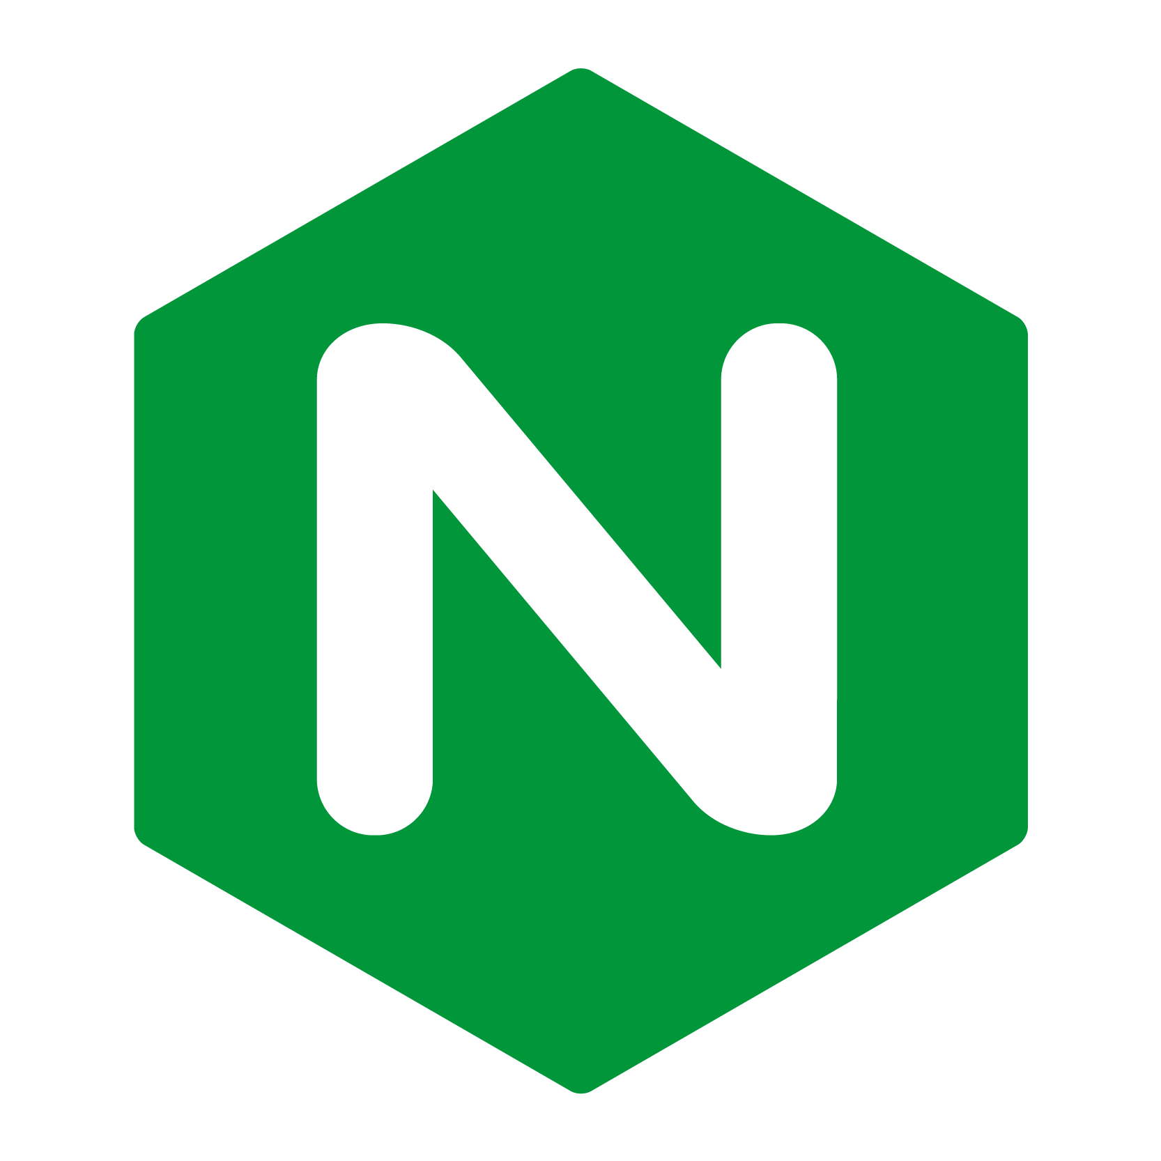




Amazon Cognito
VPC
Public subnet
Private subnet
Amazon OpenSearch Service
Users
Nginx proxy
Kibana
Private subnet
Data nodes
Service Instances
Logstash

